Slide 1
Phyloseq and Microbiome
Anders K. Krabberød

Slide 2
Phyloseq
The main page of phyloseq: http://joey711.github.io/phyloseq/
Published in PLOS ONE: Mcmurdi & Holmes 2013
https://journals.plos.org/plosone/article/file?type=printable&id=10.1371/journal.pone.0061217
Installation
BiocManager::install("phyloseq")
Designed to make it easier to import, store, and analyse sequencing data that has been grouped (or clustered) into Operational Taxonomic Units.

Slide 3
Phyloseq
It is object-oriented and can store representations of several different kinds of data
OTU abundance tables, taxonomic information, phylogenetic trees, metadata etc.
It supports importing data from a variety of common formats.
Tab

Slide 4
Phyloseq
Analyses include
calibration,
filtering,
subsetting,
agglomeration,
multi-table comparisons,
diversity analysis,
parallelized Fast UniFrac,
ordination methods,
publication-quality graphics, etc.

Slide 5
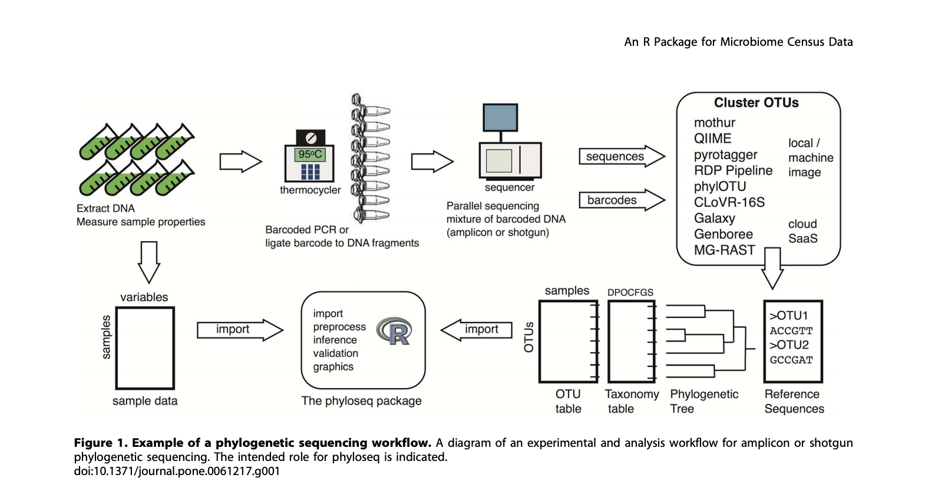
Phyloseq
Integrates many kinds of data

Slide 6
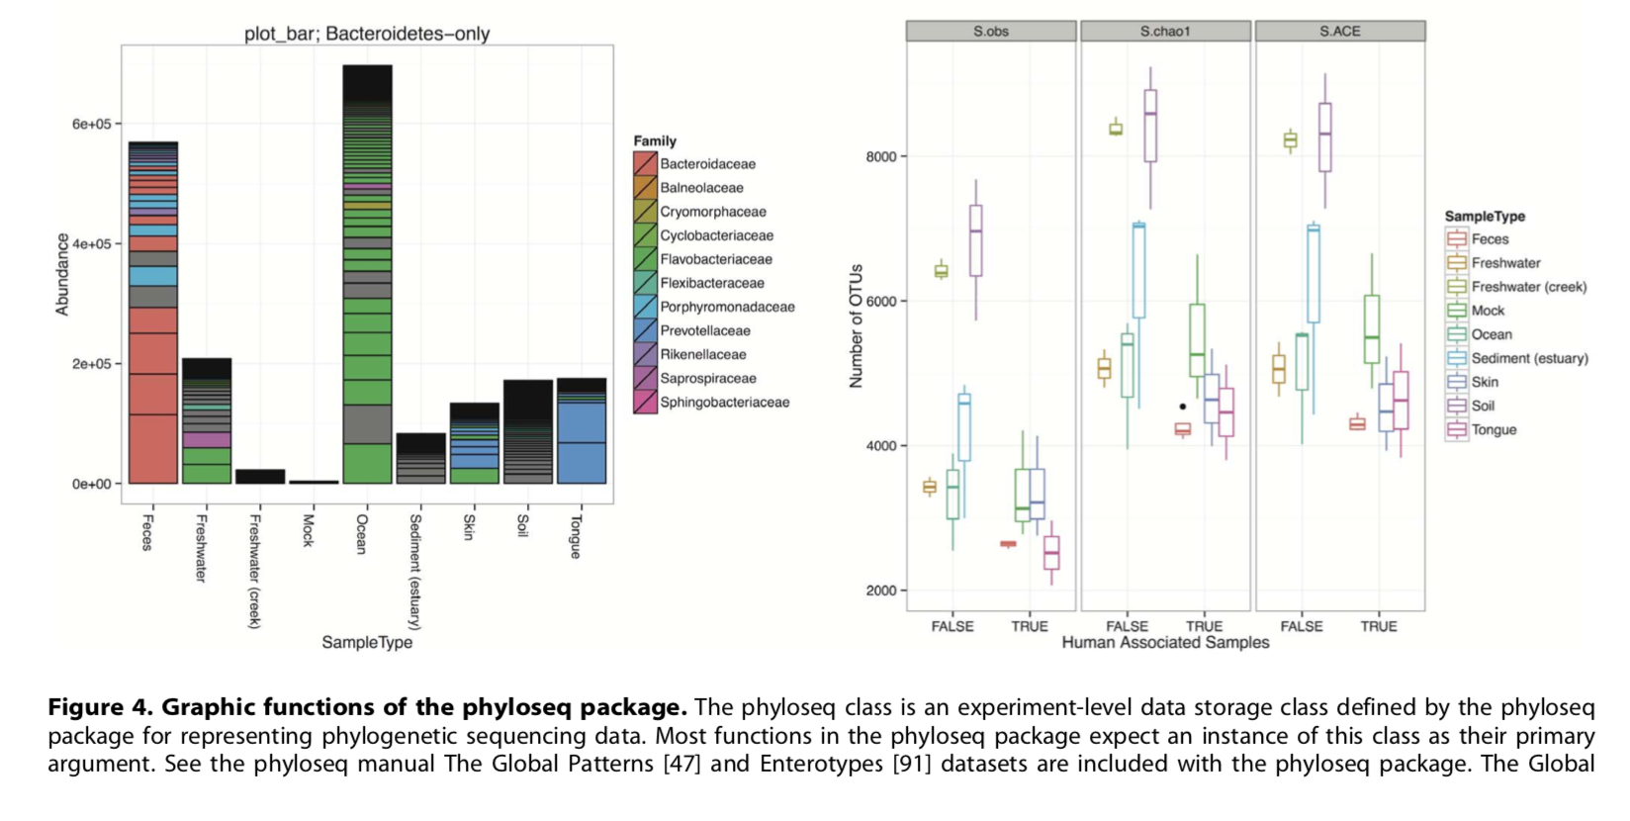
Phyloseq
Functions to make it easy to plot data

Slide 8
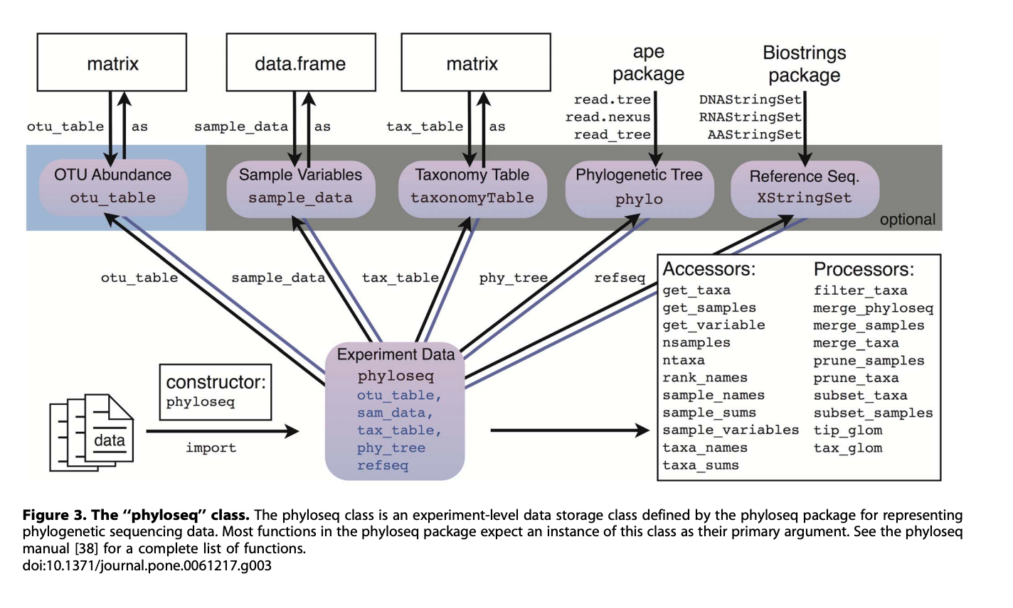
Phyloseq
Content of a phyloseq object

Slide 9
Phyloseq
Constructors

Slide 10
Constructors
Constructor for the OTU abundance matrix
otu_table()
Works on any numeric matrix. You must specify if the species are rows or columns
Default: A matrix with samples as columns and otus as rows

Slide 11
Constructors
Taxonomic assignments for the OTUs
tax_table()
Works on any character matrix. The rownames must match the OTU names (taxa_names) of the otu_table if you plan to combine it with a phyloseq-object.

Slide 12
Constructors
Metadata for samples
sample_data()
A matrix with samples as rows (!) and variables as columns
Works on any data.frame. The rownames must match the sample names in the otu_table if you plan to combine them as a phyloseq-object

Slide 13
Constructors
You can also add phylogenetic trees (Alex will do that later) and sequence data.
phylo, or XStringSet. The tip labels of a phylo-object (tree) must match the OTU names of the otu_table, and similarly, the sequence names of an XStringSet object must match the OTU names of the otu_table.

Slide 14
Phyloseq

Slide 15
Accessors and Processors
The accessors, functions used to access a particular parts of the phyloseq object
Processors, functions made to process and analyse the phyloseq object

Slide 16
Accessors
get_taxa()
get_samples()
get_variables
nsamples()
ntaxa()
sample_sums()
taxa_sums()
rank_names()
Etc.

Slide 17
Processors and plotting
merge_phyloseq()
merge_samples()
subset_samples()
subset_taxa()
plot_bar()
tax_glom()
etc

Slide 18
Phyloseq
There are many more functions.
Use help(package = "phyloseq")

Slide 19
Phyloseq
Tutorials online:
General use with examples
https://joey711.github.io/phyloseq/tutorials-index.html
https://vaulot.github.io/tutorials/Phyloseq_tutorial.html
For data import
https://joey711.github.io/phyloseq/import-data.html
Plotting trees:
https://joey711.github.io/phyloseq/plot_tree-examples.html

Slide 20
Microbiome
Also a package in R.
Developed by Leo Lahti, Sudarshan Shetty and others.
https://microbiome.github.io/
An extension of Phyloseq with a particular focus on amplicon sequencing data.
Use the same phyloseq object, have included some extra functionality
Tutorials and examples
https://microbiome.github.io/tutorials/

